Slide 1

GAYATRI VIDYA PARISHAD COLLEGE FOR DEGREE AND PG COURSES(A)
(Affiliated to Andhra University)
Department of Computer Applications
Haptic Technology
Under the Guidance of
A.Prabhakar
Assistant Professor
Department of computer Science
By
K.ManojKrishna
PG222302032(MCA)

Slide 2

Haptic
Technology
“Beyond The Screen : Where touch meets technology”

Slide 3

Contents:
Introduction
History
Haptic Feedback
Haptic Perception
Working
Architecture
Haptic Devices
Market Growth
Applications
Advantages
Disadvantages
Future Directions
Conclusion
References

Slide 4
Introduction:
Haptic technology is a cutting-edge field that focuses on the sense of touch.
Unlike traditional user interfaces that rely solely on visual and auditory feedback, haptic technology adds the sense of touch to the interaction.
It enables users to perceive and manipulate virtual or remote objects through tactile sensations.
Haptic feedback can range from simple vibrations to complex force simulations, providing a more immersive and intuitive user experience.
Applications of haptic technology span various industries, including gaming, healthcare, automotive, education, and more.
By enhancing human-computer interaction with tactile feedback, haptic technology opens up new possibilities for innovation and user engagement.
Haptic technology leverages sensory interfaces to mimic the sense of touch, allowing users to feel textures, shapes, and forces in virtual environments.
It facilitates realistic simulations and interactions, enhancing training programs, medical procedures, and design processes by providing users with tactile feedback that closely resembles real-world experiences.

Slide 5
History:
Early Developments:
  Haptic technology traces its roots back to the late 19th century with telegraphy and early attempts at tactile communication.
  The telegraph's Morse code relied on operators sensing tactile feedback to interpret messages.
Mid-20th Century Advancements:
  Significant developments emerged in the mid-20th century, notably with the creation of force-feedback joysticks for flight simulators.
  These early devices provided rudimentary haptic feedback to users, primarily in industrial and military contexts.
Emergence of Tactile Feedback:
  In the 1970s and 1980s, researchers began exploring tactile feedback for human-computer interaction.

Slide 6
  Initial experiments focused on simple vibrations and texture simulations.
Commercialization and Mainstream Adoption:
  The 1990s saw the commercialization of haptic technology in consumer products, particularly in gaming consoles and mobile devices.
  Devices like the Nintendo 64's Rumble Pak and early mobile phones with vibrating alerts introduced haptic feedback to a broader audience.
Expansion into Various Fields:
  Over the past two decades, haptic technology has expanded into diverse fields, including virtual reality, medical simulation, automotive interfaces, and more.
  Advances in hardware and software have enabled increasingly sophisticated haptic experiences, revolutionizing user interaction in numerous domains.

Slide 7
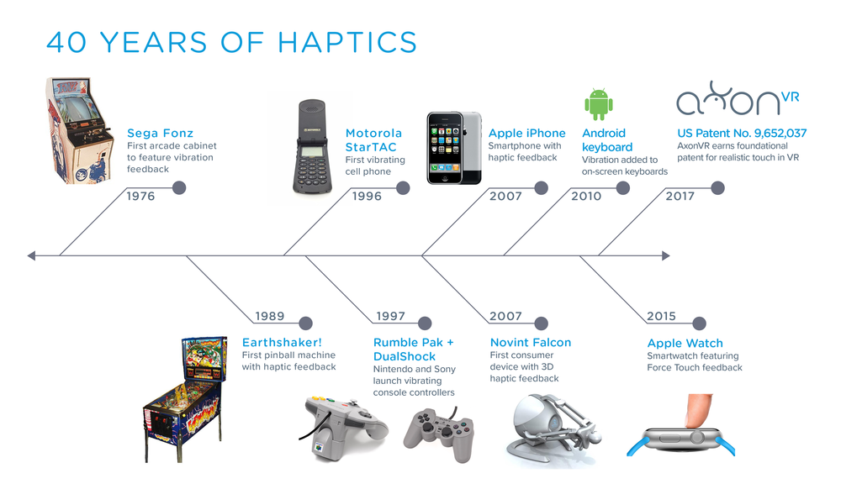

Slide 8
Haptic Feedback:
Definition
Types :
Tactile Feedback: Simulates surface textures, shapes, and contours through vibrations or surface variations.
Force Feedback: Provides resistance or forces to mimic real-world interactions, such as pushing against a solid object.
Vibration Feedback: Delivers rapid oscillations to convey alerts, notifications, or subtle sensations.
Principles
Kinesthetic Feedback: Simulates physical sensations of movement and resistance, enhancing immersion and realism.
Tactile Feedback: Utilizes surface vibrations or textures to convey information or enhance user perception.
Multi-Modal Integration: Combines various haptic modalities to create rich, interactive experiences, aligning with the user's sensory capabilities.
Haptic feedback refers to the use of tactile sensations or forces to communicate information to a user. It simulates the sense of touch, enhancing user interaction with digital systems.

Slide 9
Haptic Perception:
Haptic perception is a complex process involving the integration of sensory inputs, neural processing, and perceptual experiences.
Understanding the mechanisms and psychophysics of haptic perception is essential for designing effective haptic feedback systems.
1. Human Sensory System Overview
  Humans possess a complex sensory system enabling perception of touch, pressure, temperature, and pain.
  Haptic perception involves the sense of touch, primarily mediated by the somatosensory system.
2. Mechanisms
  The somatosensory system consists of sensory receptors located in the skin, muscles, and joints.
  These receptors transduce mechanical stimuli (e.g., pressure, vibration) into neural signals.
  Receptors vary in sensitivity and respond to different types of mechanical stimuli.
3. Psychophysics
  Psychophysics explores the relationship between physical stimuli and subjective perceptual experiences.
  Thresholds such as tactile sensitivity, discrimination, and recognition play crucial roles in haptic perception.
  Factors like texture, surface roughness, and object shape influence haptic perception.

Slide 10
Working:
Sensory Perception
Haptic Rendering
Actuator Response
Sensory Feedback Loop
Position tracking
Force calculation
Vibrotactile
Force feedback (Force reflecting)
Collision detection
Signal generation
Solenoid
Shape Memory Alloys (SMAs)
Tactile feedback

Slide 11
Architecture:
Haptic Interface Device (HID)
Haptic Control Unit (HCU)
Software
Communication Interface
This is the physical device the user interacts with, like a glove, stylus, or controller. It houses sensors and actuators.
This is the processing unit that receives data from sensors, runs haptic rendering algorithms, and sends signals to actuators
Haptic rendering software interprets user actions, calculates appropriate forces, and controls the HCU.
This connects the HCU to the computer system generating the virtual environment or application.

Slide 12
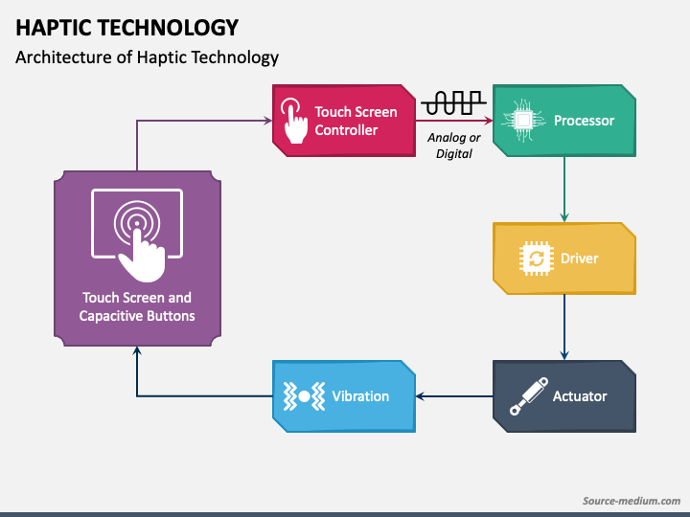
By combining these elements, haptic technology bridges the gap between the digital and physical worlds, allowing us to experience and interact with virtual objects in a more realistic and immersive way.

Slide 13
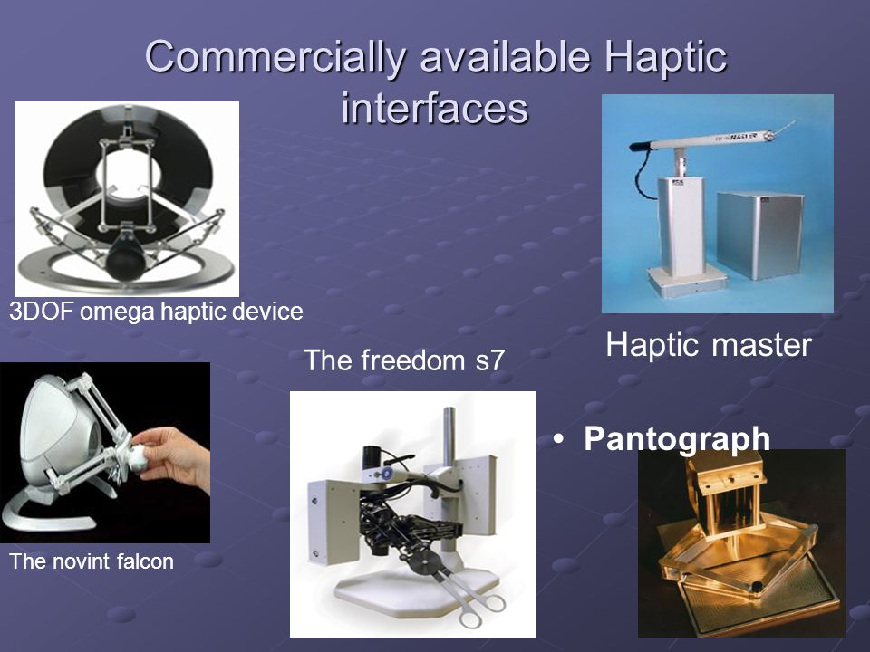
Haptic Devices:

Slide 14
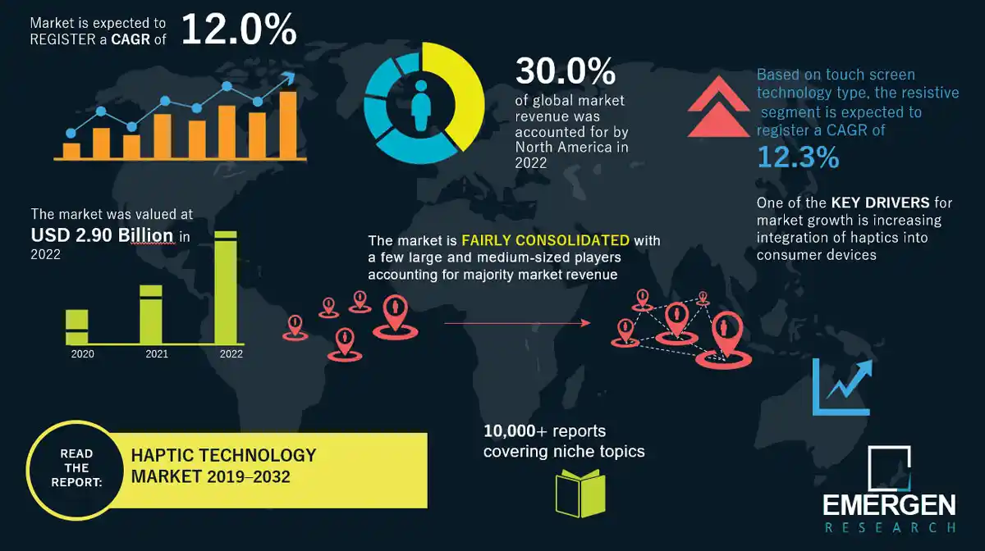
Market Growth:

Slide 15
Applications:
Gaming experience can be greatly enhanced by applying force feedback .
Multi-media publishing Currently include text,sound, images and video.
'Mechanical Documents' could be transmitted by conveying material properties .
Scientific Discovery Data display .
Remote sensing, mining in geology (oil and gasprospecting)
Arts and Creation Artists and musicians, virtual exhibitions of paintings and sculpture .
Vehicle operation iDrive in BMW and Rolls Royce Engineering CAD
Education and Training surgical training, pilot training
Virtual Reality (VR) and Augmented Reality (AR)
Gaming and Simulation
Medical Training and Rehabilitation
Industrial Design and Prototyping
Remote Control and Teleoperation

Slide 16
Advantages:
Potential benefits
Reduction in fatigue.
Increase in productivity and comfort.
Decreased learning times.
Reduction in manipulation errors.
Stress Reduction and Relaxation
Increased Safety in Hazardous Environments
Enhanced Spatial Awareness

Slide 17
Disadvantages
Future Directions:
Cost is high
Large weight and size of haptic devices
Haptic interfaces can only exert forces with limited magnitude
Many haptic projects rely on fixed installations and they are not easily portable
Advances in Haptic Technology: Development of more sophisticated haptic devices with greater fidelity and versatility.
Integration with Artificial Intelligence: Leveraging AI algorithms for more realistic and adaptive haptic simulations.
Haptic Internet: Exploration of haptic communication networks for remote tactile interactions.

Slide 18
Conclusion:
Haptic technology has the potential to revolutionize how we interact with digital content and the physical world, offering new dimensions of sensory experiences.
As haptic technology becomes more widespread and accessible, it is essential to consider usability, accessibility, and ethical implications to ensure inclusive and responsible deployment.
The journey of haptic technology is just beginning, and the possibilities for innovation and creativity are limitless. Embracing this technology opens doors to exciting new opportunities for human-computer interaction and beyond.
This concise conclusion slide provides a wrap-up of the key points discussed in the presentation, offers insights into the future of haptic technology, and leaves the audience with final thoughts to ponder.

Slide 19
References:
http//www.docstoc.com/docs/2685206/Introduction-to-Computer-Haptics
V. Hayward, O. Astley, M.C. Hernandez, D Grant,G. Torre, Haptic Interfaces and devices, Sensor Review, Vol.24. 2004.
Mandayam A Srinivasan, What is Haptics?,Laboratory for Human and Machine Haptics The Touch Lab, Massachusetts Institute of Technology.
L. Bonanni, J Lieberman, C Vaucelle, O Zuckerman,TapTap A haptic wearable for asynchronous distributed touch therapy, Proc CHI 2006.
M Srinivasan,C. Basdogan, Haptics Display in Virtual Environment,Computer Graphics,Vol. 2,1997

Slide 20
Thank You

